Slide 1
VP-MFG.COM
Instructions for Brass Reamer

Slide 2
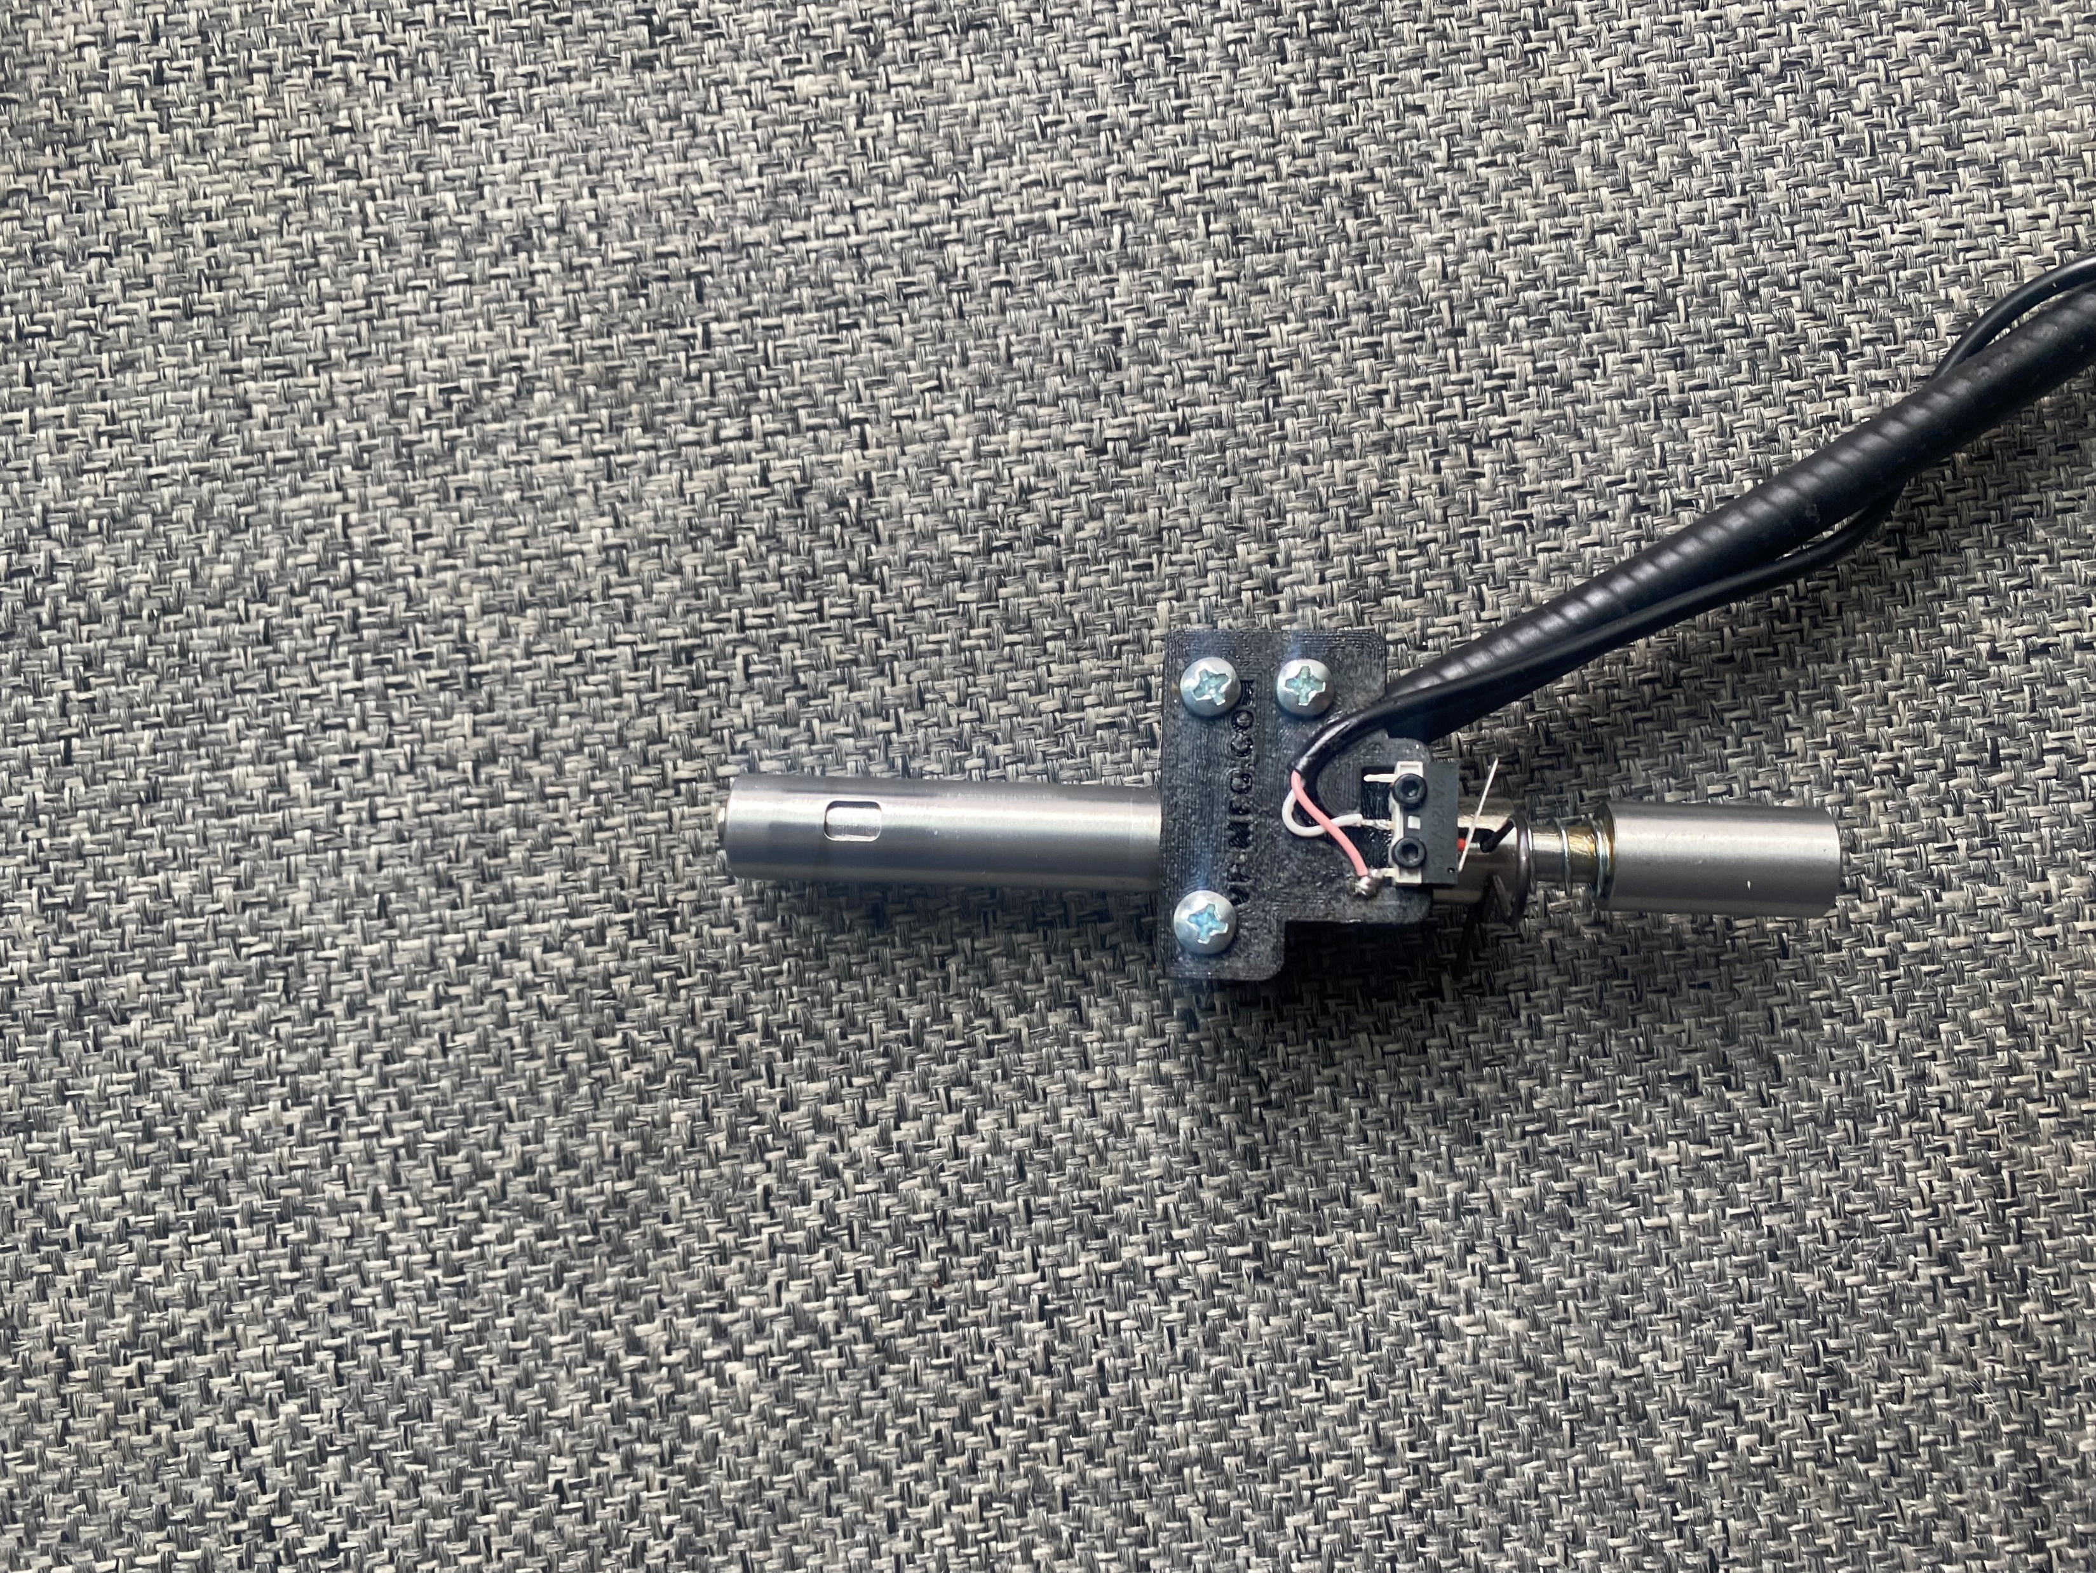
Dillon 1050 reamer
CP2000 and RL1100 Reamer
There are two types of reamers based off what machine you're going to use them on. The left is a 1050 and the right is the CP2000/RL1100 reamer. This unit will still need a swage backer installed above it. The only backer die that I recommend is the FW ARMS spring loaded hold down die. Reamer tip design is custom and enables reaming to be based of the headstamp and not the flash hole height.

Slide 3
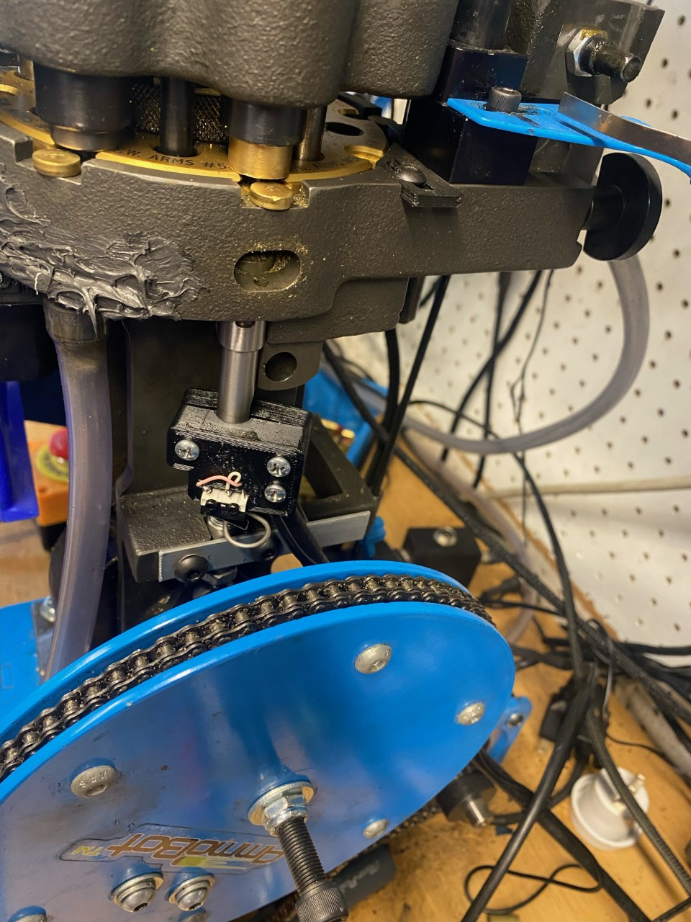
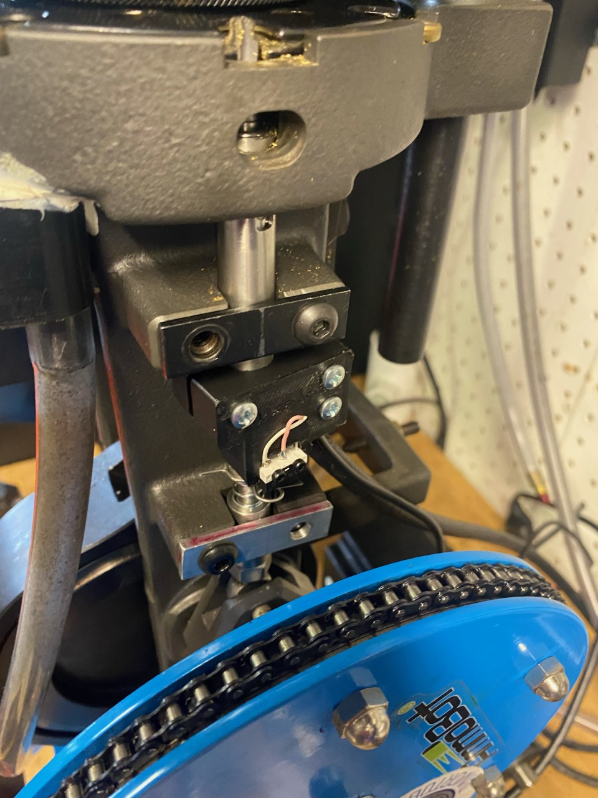
This is an example of the orientation of the 1050 style reamer. The drive box is usually to the right and back of the press if standing in front of the press. On the 1050 you will need to remove the priming arm and related components. See the circled spot above for the bolt to remove. If you have an aftermarket return spring, you will have to figure out a different way to attach it possibly.
This is an example of the orientation of the CP2000/RL1100 style reamer. The drive box is usually to the right and back of the press if standing in front of the press. This is on the right side of the press swage station on the CP2000. If using this on the left swage station, you will need to remove the case feeder support bar.

Slide 4
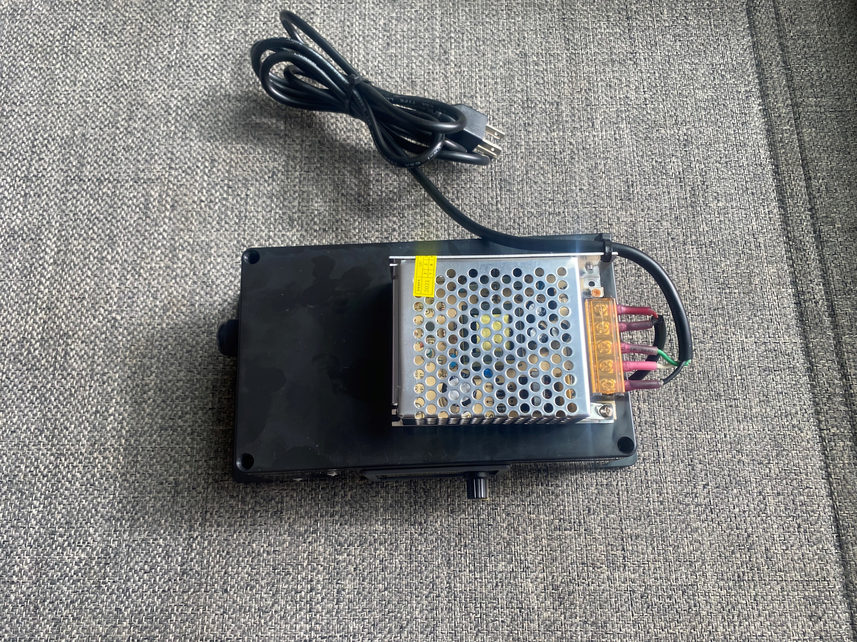
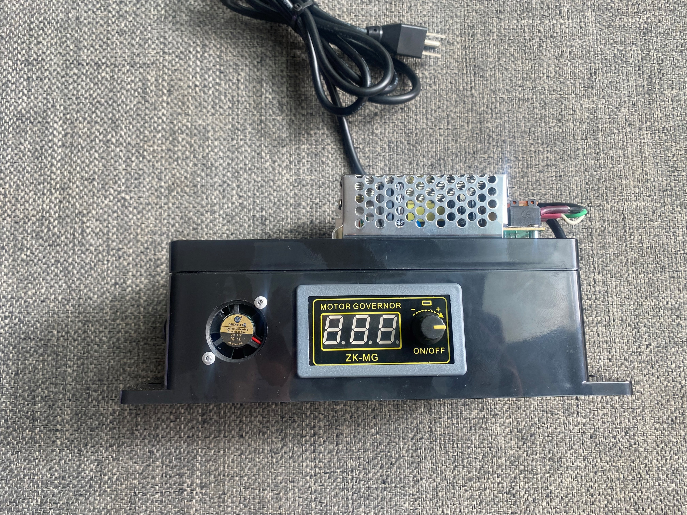
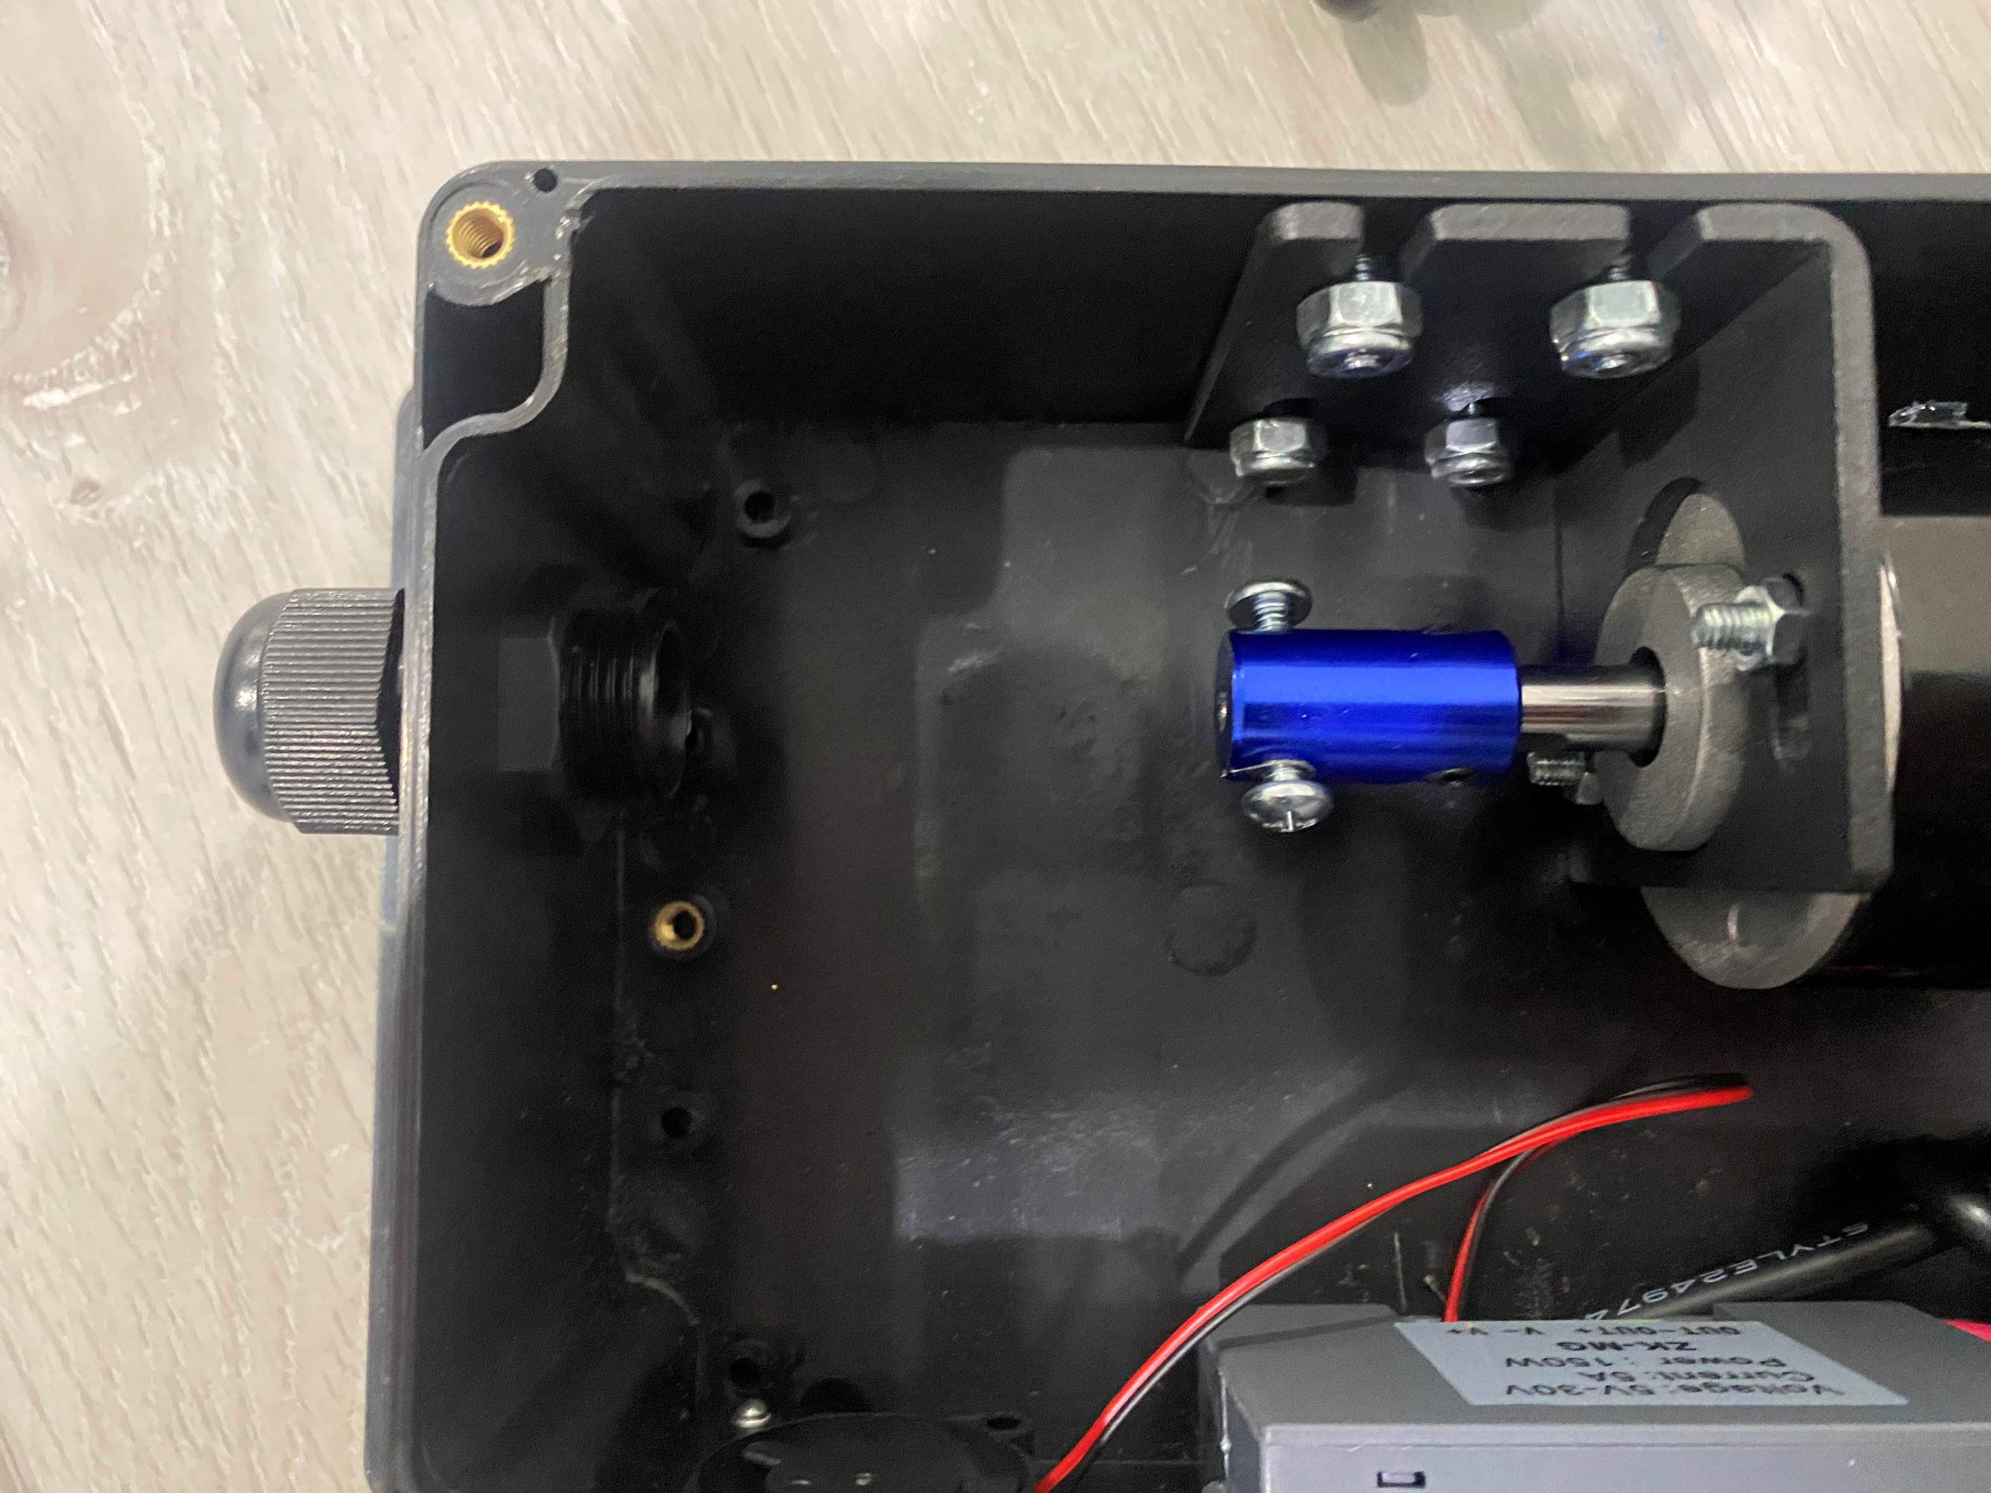
When you receive the reamer, it will come in 2 pieces and needs to be put together.
Note: Image 2 and 3 are the same thing just turned on its side to give more detail.
1
2
3
4
Cable end
Retainer nut
Cable drive
Step 1: Remove the 4 screws from the top of the drive box.
Step 2: Insert the cable end into the drive box retainer nut.
Step 3: Guide the cable end (IMG 1) into the cable drive adaptor (IMG 4)
Step 4: Tighten down the screws on the cable drive securing the cable end
Step 5: Reinstall the top cover plate and 4 screws removed in step 1.

Slide 5
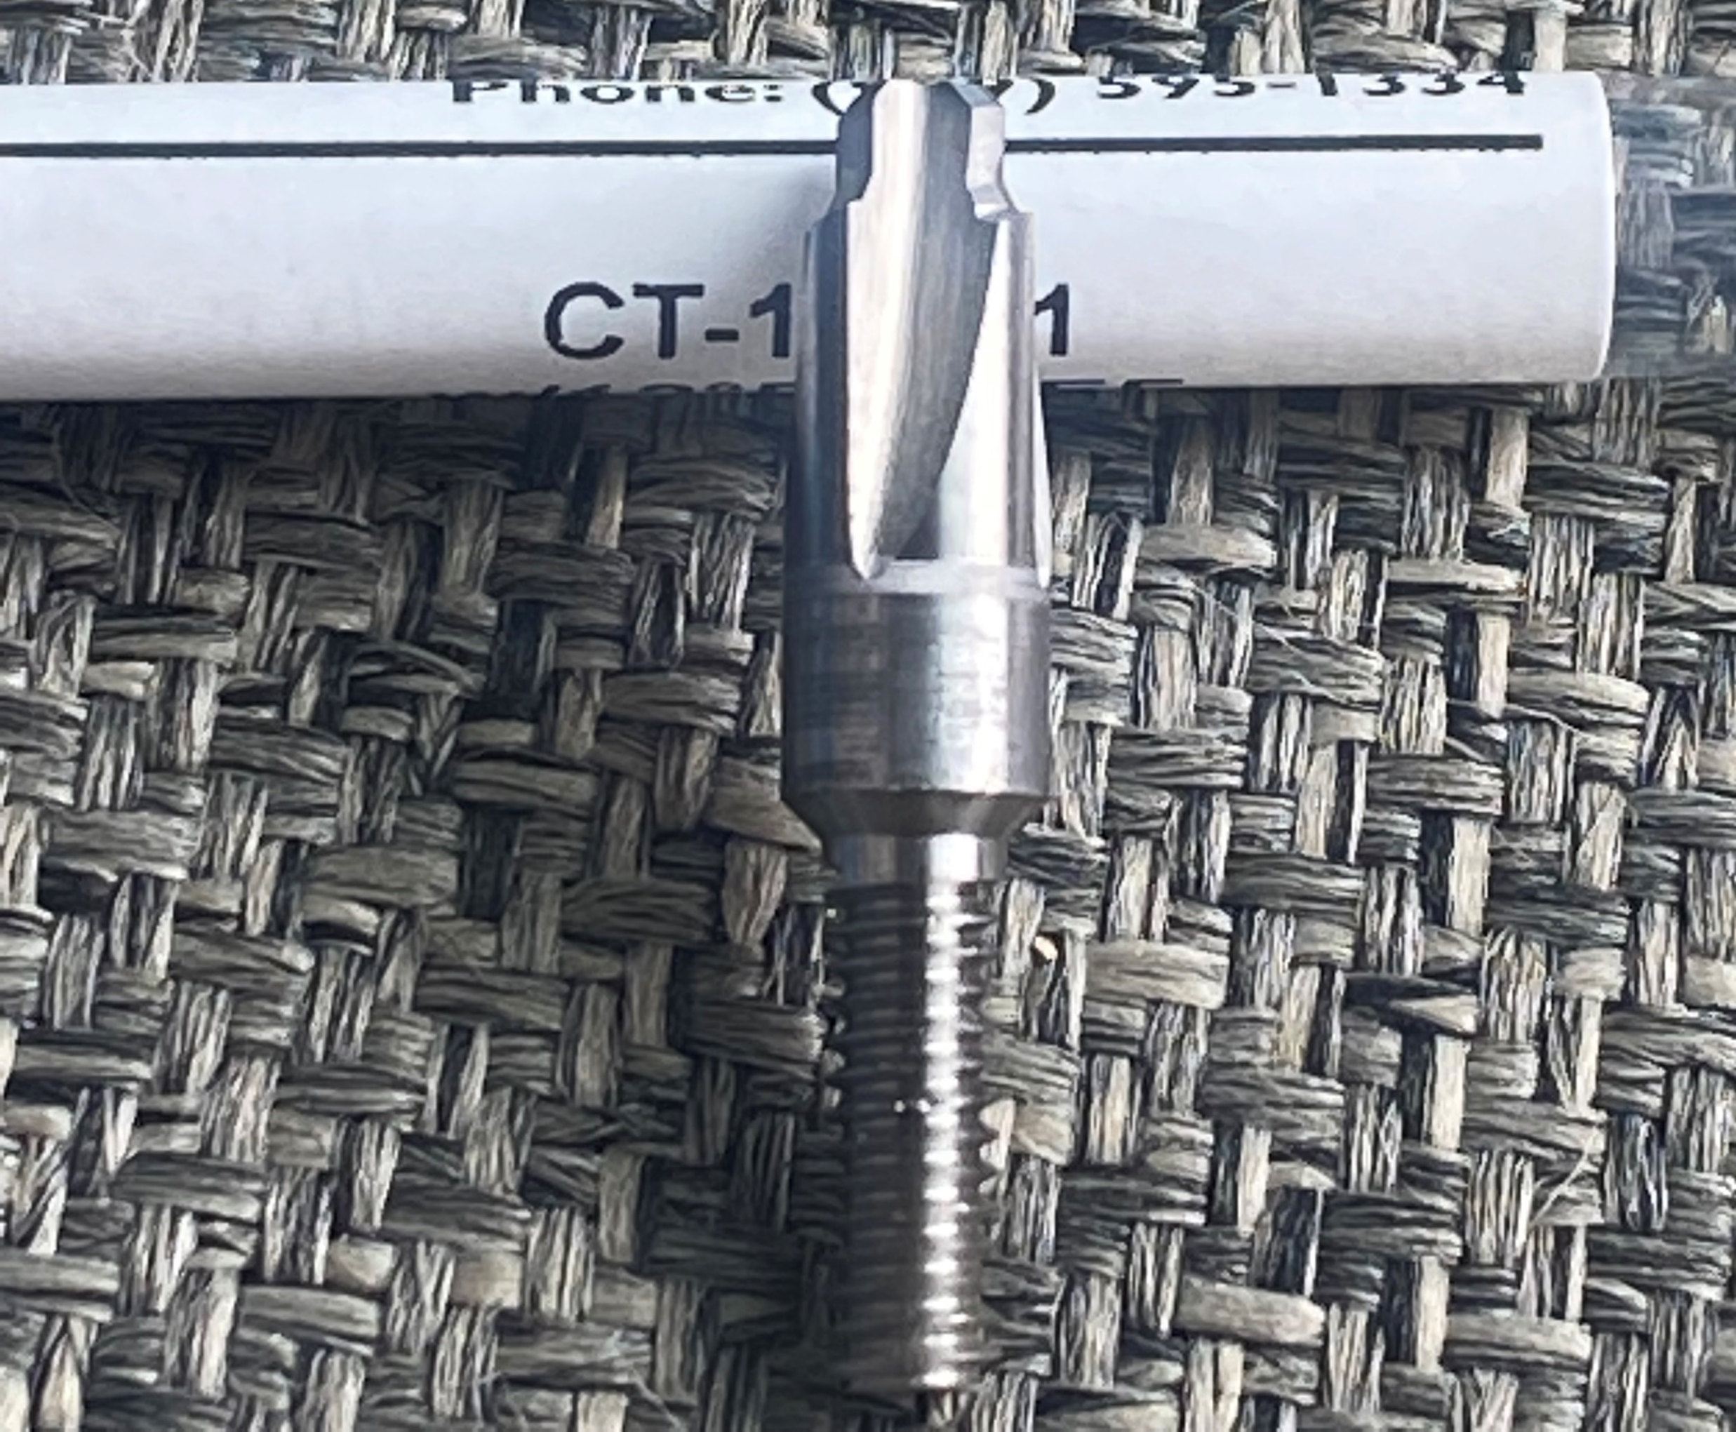
6
5
7
You want this hairpin clip to move just a little bit when setting up with de-primed case.
Step 6: Now that you have the complete reamer assembled you need to install the tip (IMG 5) into the top of the unit. Then slip the dust washer over the tip. It just rest in place. The purpose of this washer to help keep brass shavings out of the bearing assembly. Then install the plastic washer over the tip. This is to help keep debris out of the bearings.
Step 7: Install the reamer into the swage rod location with your existing swage rod eye bolt. I have found it the easiest to install it by moving the swage rod eccentric to the side and compress the spring on the reamer unit. (On the 1050 press’s you will need to remove the priming arm to accommodate the room for this unit)
Step 8: With the unit powered off insert a de-primed case into the reamer’s location and lower the press to the bottom of the stroke. While visually inspecting the amount of movement that the spring has compressed (IMG 7). You want just a little bit of compression of the spring. See IMG 7 comment. There is no need to tighten the eye bolt locking nut down excessively on this unit. Simply remove the clevis pin and lift the unit up and rotate the swage cam out of the way. Then just turn the eye bolt to achieve the desired height.
Step 9: With the press still lowered you will need to adjust the cable retainer housing for proper setting of the switch height. To do that loosen the circled screws in IMG 6 and move up or down to accommodate the correct position of the switch. You want the switch to trip on ringers and missed de-primes but not false trip on cases that are fine. It may take you some trial and error, but you will find a happy spot that works. Something that helps me is testing the switch with a case that still has the primer and even better yet if you have a ringer laying around test it with that.
Step 10: Now secure the black shaft cable housing to the drive by applying a slight pull on the black cable shaft housing and while holding a slight tension tighten down the retainer nut in IMG 4.

Slide 6
Step 10 continued.
After final adjustment of the switch housing please ensure that the flexible cable is centered in the cutout that is circled. Failure to ensure that the cable is not hitting the side of the reamer body cutout (indicated by the yellow lines) will eventually lead to cable failure as it is spinning and contacting the body.

Slide 7
8
Step 11: For the Dillon 1050 you will need to install the provided swage rod retainer plate IMG 9 shows the correct instillation orientation.
Step 12: Turn the power to the drive on and verify that the tip is not contacting the shell plate. This can be done by cycling the press without any brass in the machine and notice if there is a pitch change or a chattering noise when the reamer tip is coming through the shell plate. If it does contact the shell plate it will likely over time damage the tip and flex shaft.
Step 13: Install the vacuum attachment. It is held on with magnets, but I recommend that you silicone or plumbers putty the attachment to the frame for the most secure attachment. The hose barb will need to be connected to a strong vacuum source to evacuate chips and cool the bit during operation.
Step 14: Run some brass and figure out what speed works for you. Often pistol brass will need less speed and cutter contact time than rifle brass will. I find that starting at 60% on the display works as a good starting point for pistol and 70% for rifle. This will all depend on the amount of time the cutter is in contact with the brass and the user preference. I don’t recommend to run the machine past 95%.
Lubricate heavily to flush any brass debris from the points indicated in IMG 8 approx. every 2000-5000 cases with some type of thin lubricate like WD-40. I would recommend that during initial break-in (first 2000 cases) of the reamer that it be lubricated every 500 cases.
NOTE: Don’t run the reamer into a piece of brass and leave it on the down stroke as it will ruin the brass and may damage the cutter. (IE don’t start you ammobot or autodrive with the brass in the reamer location as it will damage the brass)

Slide 8
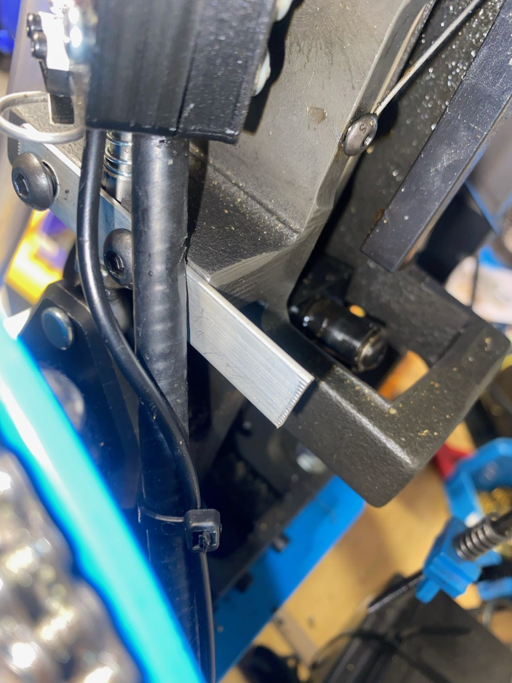
9
Retainer plate keeping the cable from hitting on the frame
If you need to disassemble the reamer you need to apply Locktite 620 retaining compound to the outside of this bearing prior to reassembling.
These are the bearings that you need to keep lubricated.
Ensure when adjusting the cable retainer housing and switch that the flexible cable dose not hit the edge of this cutout. When maintenance the reamer pack this opening with standard grease.
Set screw locations to remove the flex drive cable from the reamer assembly.

Slide 9
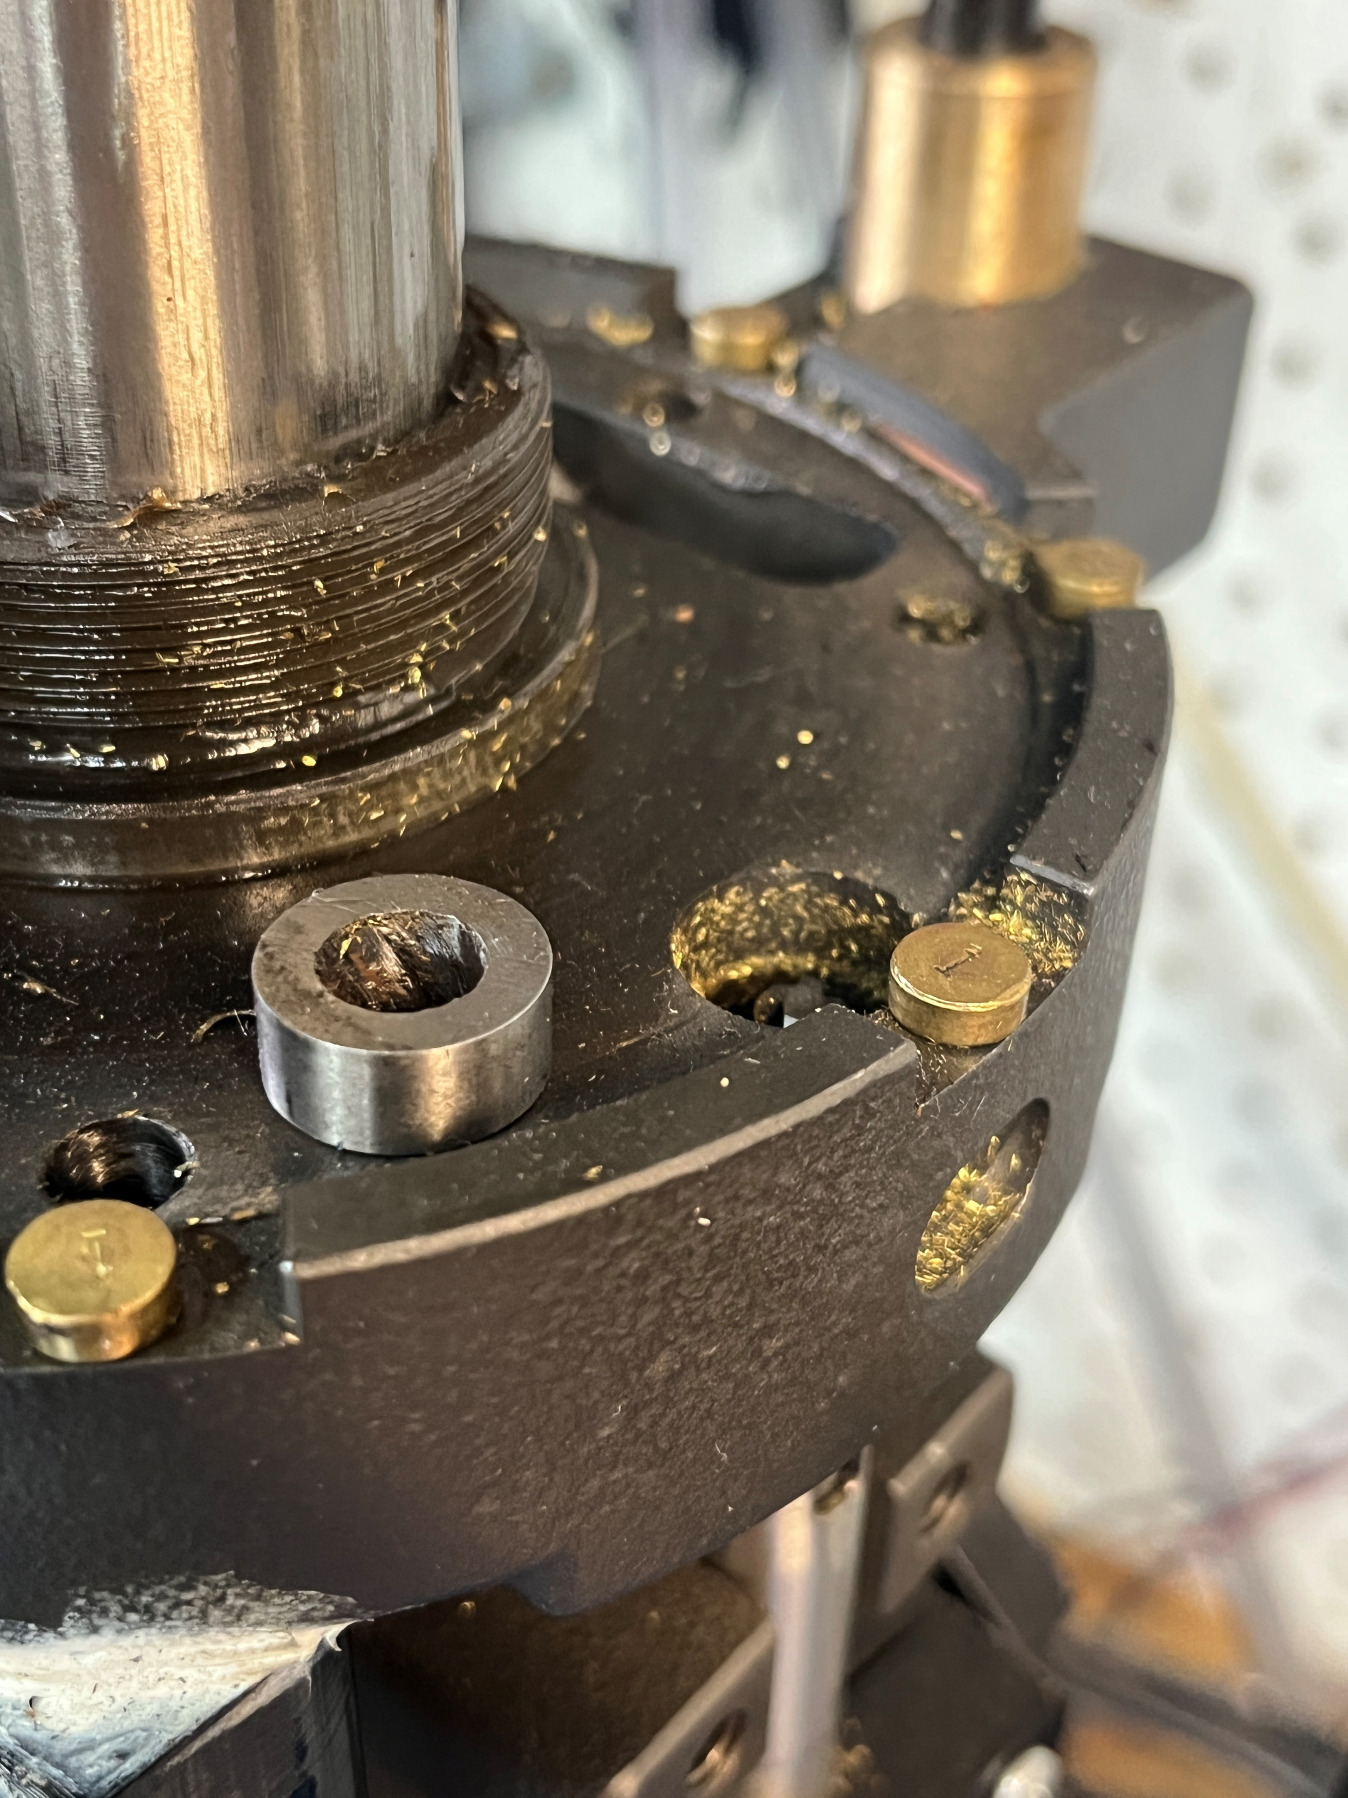
Large Reamer install
In order to use the large reamer you will have to remove the hardened bushing from the frame. This is an example of the bushing out of the frame. When using the reamer it is not necessary to use it and makes your vacuum better. To get this out you will drive the bushing from the bottom up. Basically the bushing will only come out from the top. It will also be recommended that you use the 24V power supply instead of the 12V for the small pocket reamer.

